Slide 1
FLIGHT DELAY PREDICTION
UCB w261 Section 5 Team 3-1
AUG 11, 2023
Notes:
Adam

Slide 2



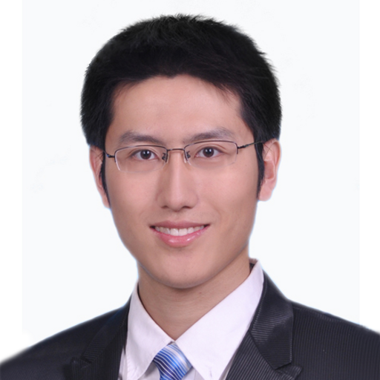
TEAM
A Adam Saleh
Liang Li
Qian Qiao
Shuo Wang
Teammate
Teammate
Teammate
Teammate
Notes:
Adam

Slide 3


AGENDA
Project Purpose - Business Case
Data Exploration & Analysis
Modeling Approach & Aspects
Results & Discussion
Challenges & Next Steps
Conclusions
Notes:
Adam

Slide 4



PROJECT DESCRIPTION - BUSINESS CASE
Problem: US Flight delays ⇒ affecting consumers nationwide
Objective: Develop a predictive model that can anticipate flight delays (>15 mins) & help consumers
Data Source: ATPW airline & weather data for 2015 to 2021
Notes:
Adam

Slide 5
Data Exploration & Analysis
Notes:
Shuo
In the EDA steps, we explored a few strategies to improve the signal-to-noise ratio of the data by summarizing the table, checking number of duplicate rows, plotting distribution of missing values for each column, characterizing the label data, and evaluating the correlation between numerical features and label data

Slide 6
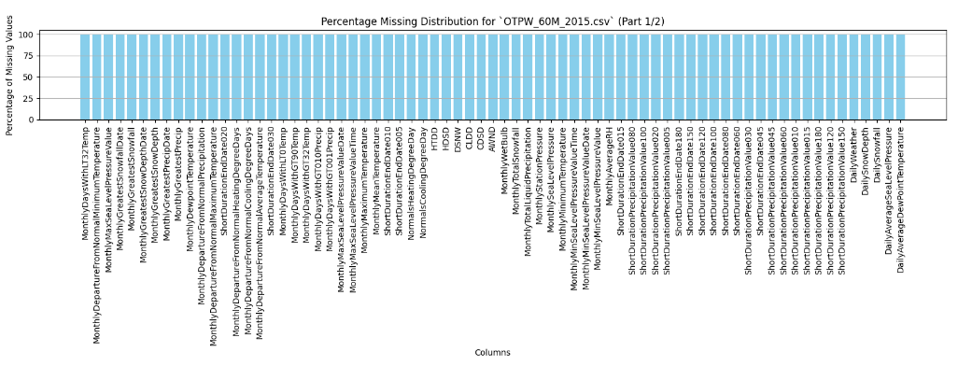
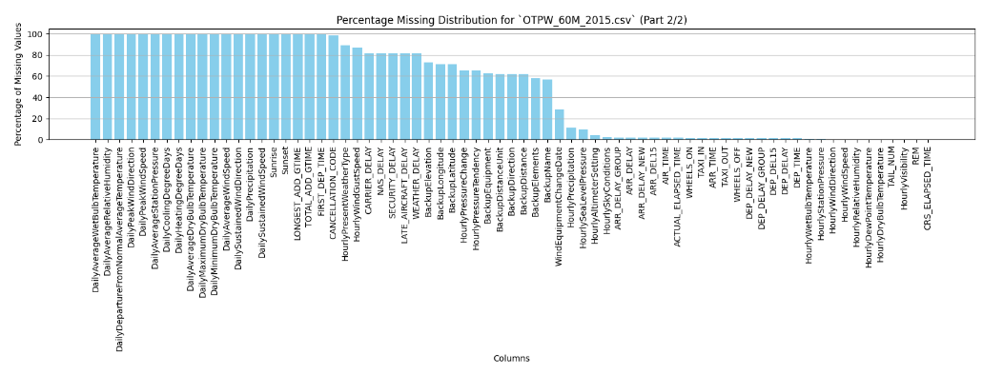
EDA - MISSING DATA
~ 44% of columns
contained > 90% missing
Notes:
Shuo
To further reduce the dimensionality of the data, we plotted the distribution of columns with missing values. As shown in the histogram, half of the columns have more than 60% missing values. We decided to drop the columns with 50%+ missing values. This threshold will be further examined in later phase.

Slide 7
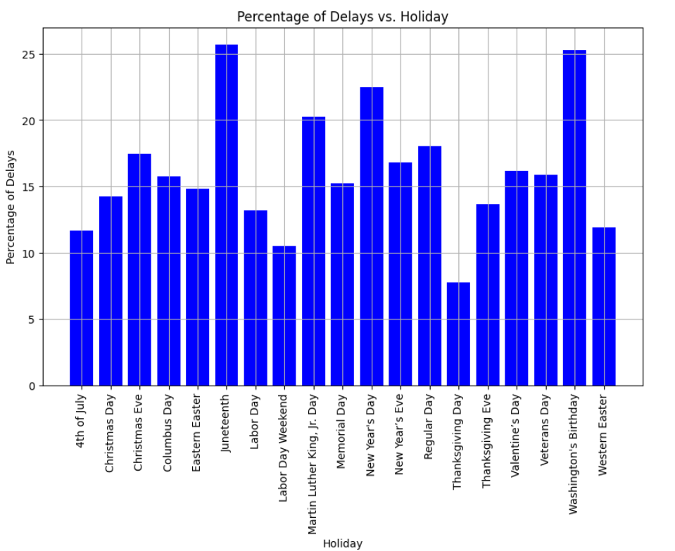
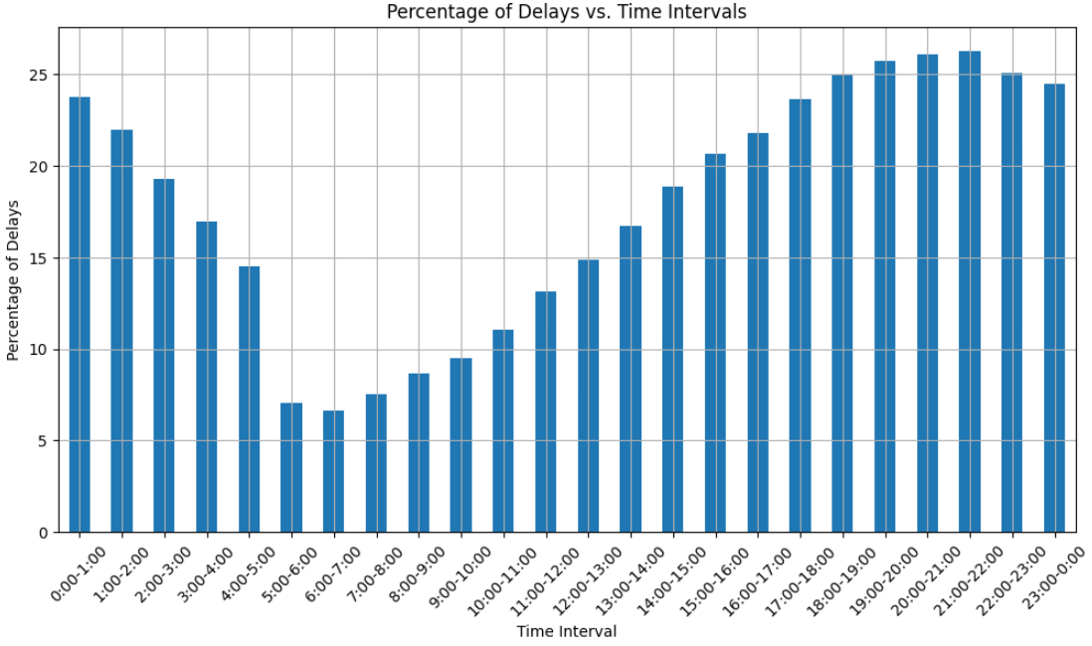
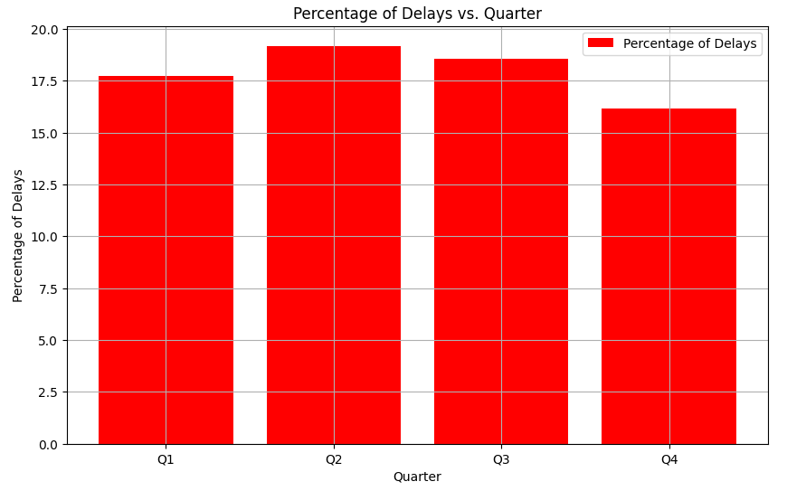
EDA - SEASONALITY
Delayed Flights by Holidays
Delayed Flights by Hour
Delayed Flights by Quarter
Notes:
Shuo

Slide 8
FEATURE ENGINEERING
Dataset: OTPW_60M
Missing value columns removal
Constant value column removal
Feature selections and transformation
Quadratic transformation and logarithmic transformation
Create new relevant features
Seasonal features (Delay_Daily_Prob & Delay_Season_Prob)
Graph feature addition - Outdegree
Feature for train/validation/test split - WEEK
2-hour Requirement feature addition - DEL_W2HR
1. Initial Joined Table: 214 columns
2. Filtered columns with 90% missing data: 122 columns
3. Removed one-value columns: 121 columns
4. Transformation of Categorical features:
30 columns
5. Add Square & Log term:
42 columns
6. Final features
46 columns
UCB W261 TEAM 3-1
August 11, 2023
8
Notes:
Shuo
Transformation for One-Hot encoding

Slide 9
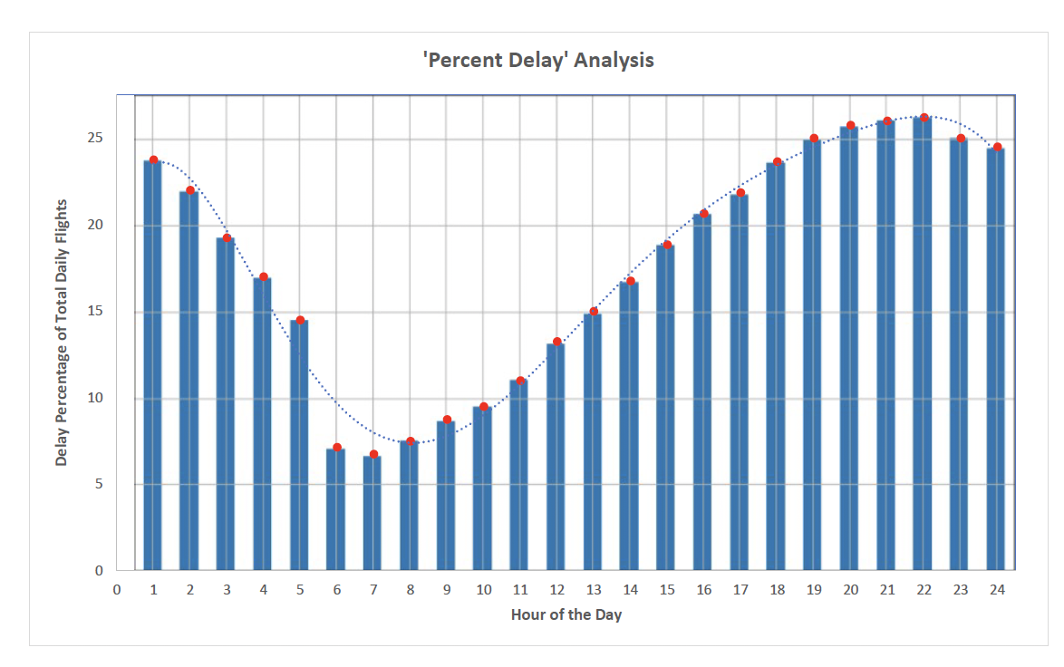
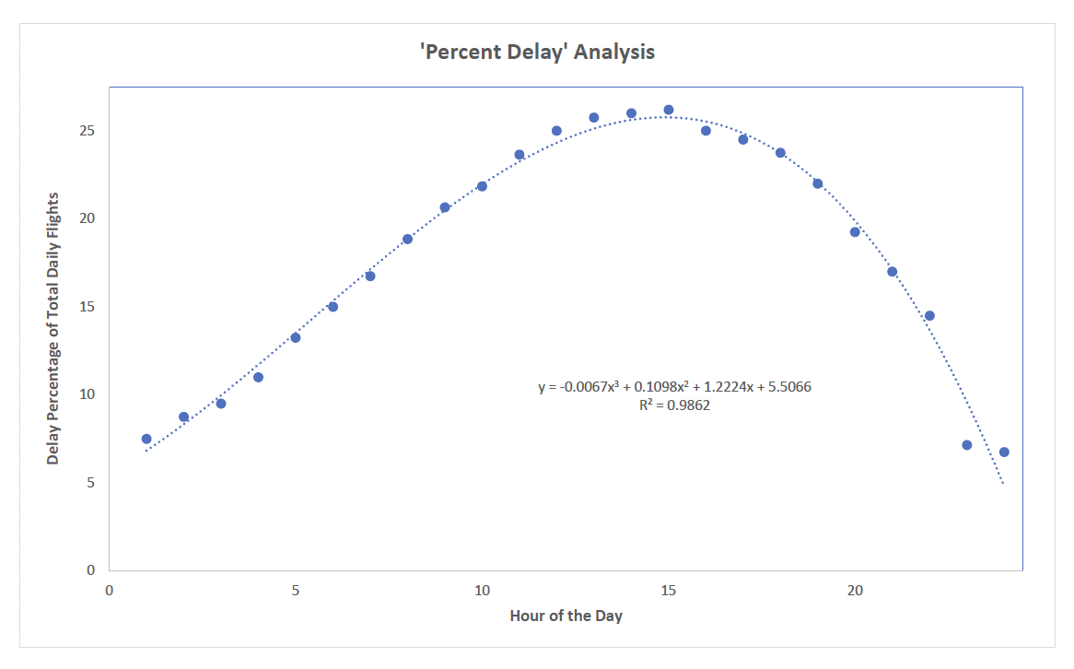
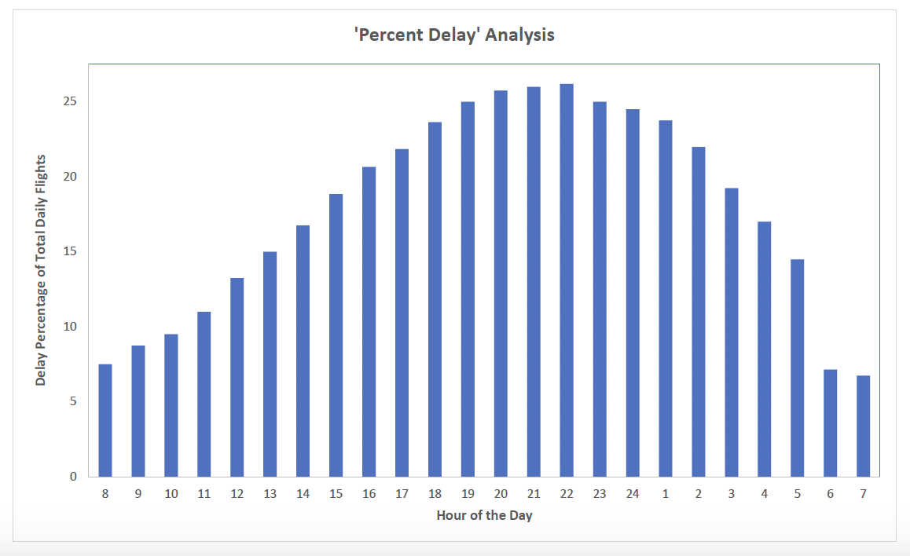
FEATURE ENGINEERING - SEASONALITY
Delay_Daily_Prob Feature: Given flight departure time ⇒ compute delay probability using historical records & established trend
UCB W261 TEAM 3-1
August 11, 2023
9
Notes:
Shuo

Slide 10
Modeling Approach & Aspects
Notes:
Qian

Slide 11
MODEL PIPELINE
Pre-Processing Steps
Staging
Indexing
OneHotEncoding categorical
Imputing categorical
Imputing numeric
list(indexers) +
list(ohes) +
[imputer_num] +
Vector=>features + label
Scaling
Pipeline(stages = model_matrix_stages +
[scaler]+
[selected estimator] )
Numeric Features
Estimator
LogisticRegression or Random Forest
Year 2015 to 2018
Divide into CV folds
(for HP Tuning)
Train
Model
Data
Year 2019
Prediction
Test
UCB W261 TEAM 3-1
Notes:
Qian

Slide 12
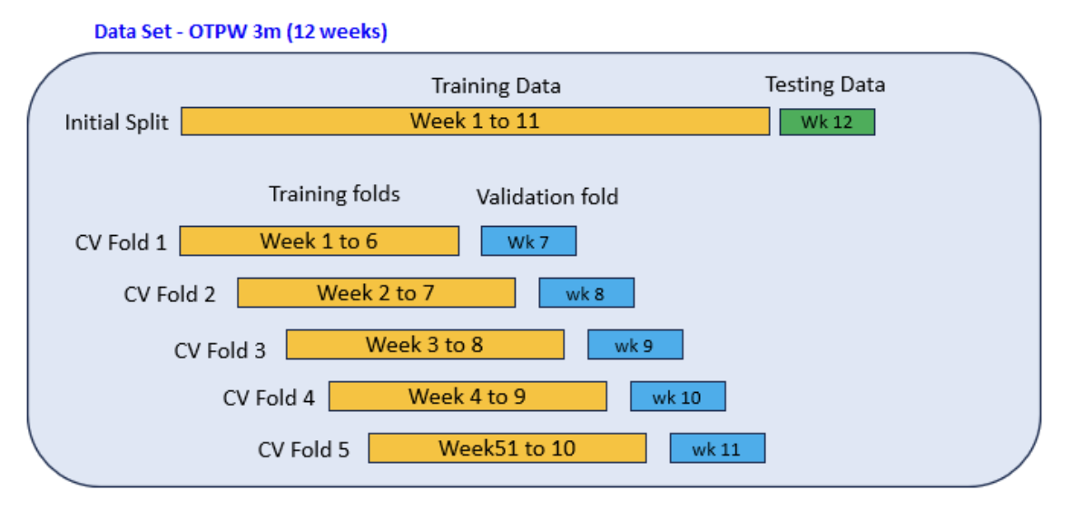
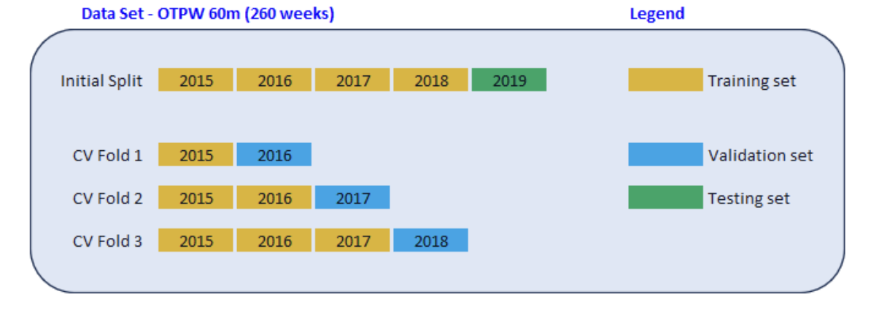
CROSS-FOLD VALIDATION
Approach prevents Data Leakage
Notes:
Qian
Be ready to explain manual cross validation techniques during hyperparameter tuning

Slide 13
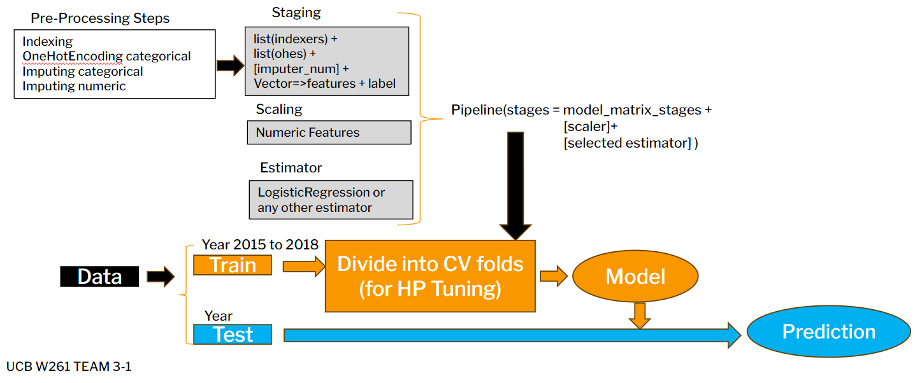
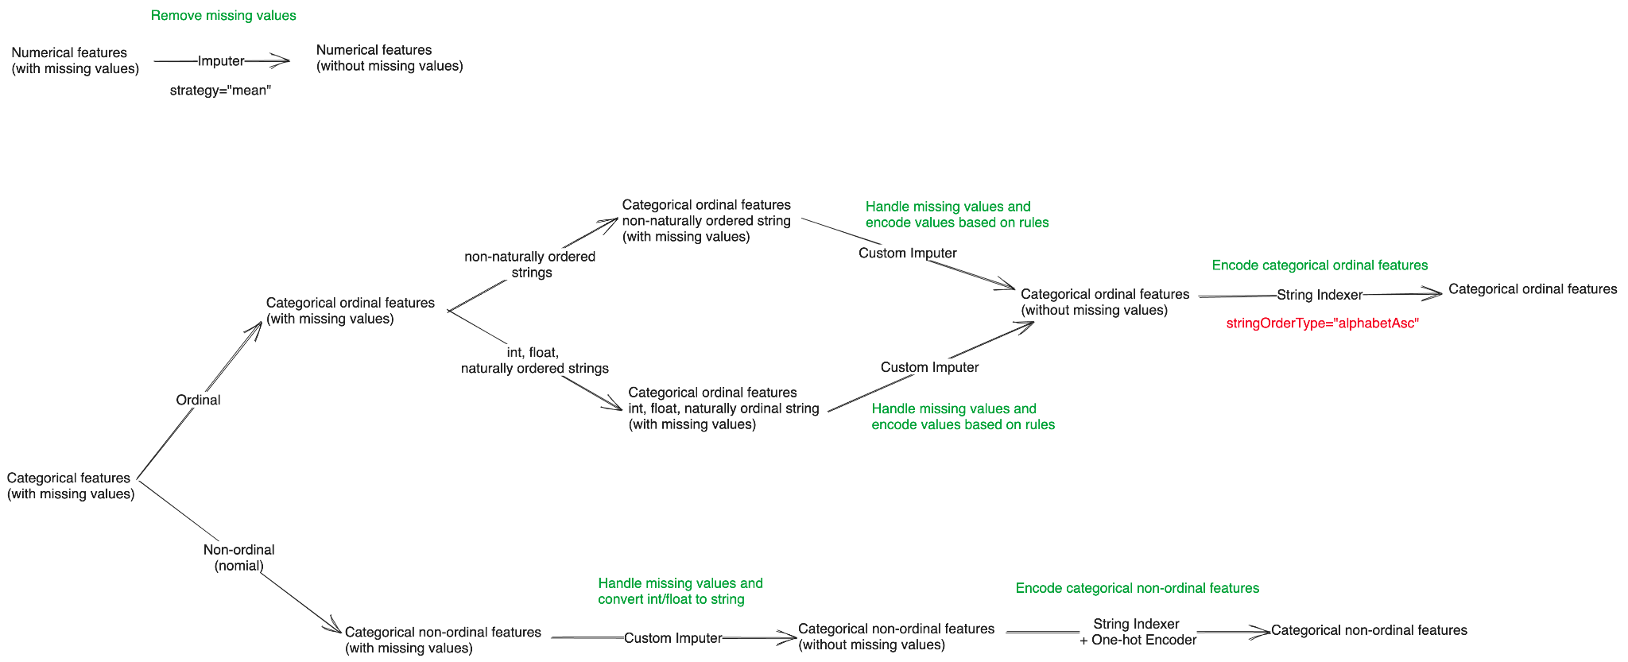
PREPROCESS STAGE
Numeric Features Path
Ordinal Features Path
Imputation & Encoding Process:
Based on Training Data & Applied to Both Train & Validate/Test Datasets
Approach prevents Data Leakage
Non-Ordinal Features Path
Notes:
Qian
Be ready to explain manual cross validation techniques during hyperparameter tuning

Slide 14
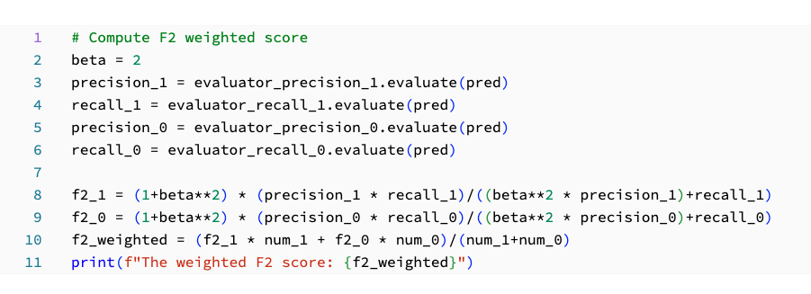
EVALUATION METRICS
F2 - F Beta Score (Beta = 2.0)
Weighted F2
F2 - Label 1 (yes delay)
F2 - Label 0 (no delay)
F1 Score
Accuracy
Precision
Recall
ROC-AUC
Key metric given importance of FN prediction
Basis metric for HP tuning
Custom computation for weighted F2
Used for comparison and trend monitoring
Notes:
Qian
Be ready to explain manual cross validation techniques during hyperparameter tuning

Slide 15
Modeling/Solution Approach
Develop base case using 3M data (Case 2)
Experiment with various factors exploring FE, different estimators, and CV techniques (Cases 1 - 14)
Select best estimator (RF) and tune HPs using 3M data (Case 6)
Implement NN MLP algorithm ⇒ predict prob(delay) for all recs in 60M data (Case 14)
Incorporate NN produced probability column into 60M data
Train the RF model with selected HP based on Case 6 and using modified 60M data (Case 15)
Obtain prediction & assess performance
Novel Approach
Notes:
Adam

Slide 16
Results & Discussion
Notes:
Liang

Slide 17
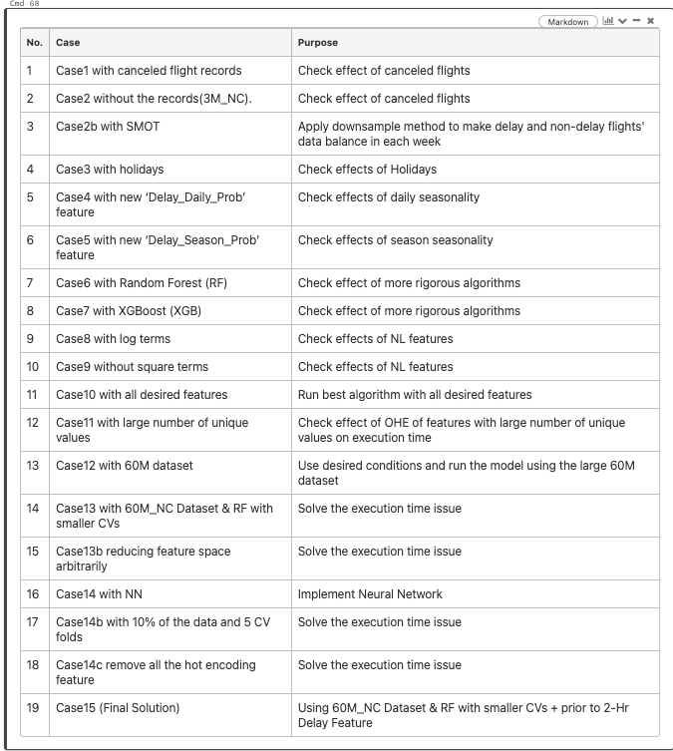
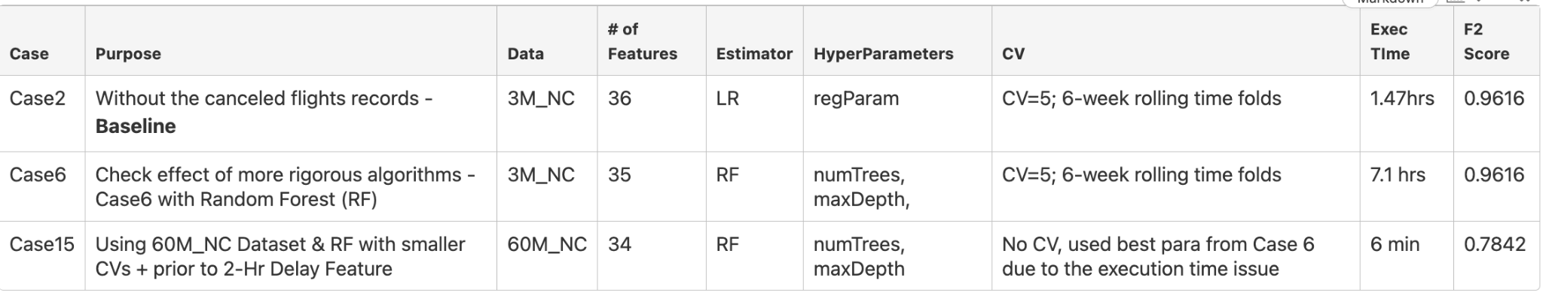
EXPERIMENTS
Notes:
Liang
We conducted 15 experiments to assess different conditions of the flight delay prediction problem as shown in the table. The purpose of these experiments is to identify the best combination of features, hyperparameters and modeling conditions that can result in the most accurate prediction of flight delays. Most experiments were performed on the smaller dataset (3-month) to save experiment time.

Slide 18
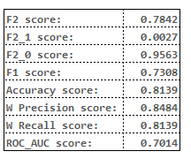
MODEL PERFORMANCE
Best model
Estimator: Random Forest (default HP + 50 trees and 5 for maxDepth)
Training data: OTPW 2015-2018
Testing data: OTPW 2019
Number of features: 34 including feature with 2-hour limit `DEL_W2HR`
Tuned Hyperparameters: numTreesList = [20, 50, 100], maxDepthList = [5, 10, 15, 20]
Performance
Notes:
Liang
Based on the experiment results, it is identified that the final best model is the Random Forest model trained on 5 years data, employing 50 trees with a maximum depth of 5.
For the test set, the Random Forest model predicts that 18% of flights will experience delays, while the remaining 82% will maintain their scheduled departure times. This class distribution indicates a certain level of class imbalance, with delayed flights being the minority class. The F1 score is 0.731, suggesting that the model achieves a reasonable trade-off between minimizing false positives and false negatives. The weighted F2 score is 0.784, this indicates that the model's performance is strong in capturing the positive class while also considering precision and recall trade-offs.
Diving deeper, the F2 score for the positive label is 0.003, indicating that the model struggles to accurately identify delayed flights, while for the negative label, it is 0.956, indicating strong performance in correctly classifying on-time flights.
The model achieves an accuracy of 0.814, meaning that the model correctly predicts the class of approximately 81.4% of instances. However, due to class imbalance, accuracy alone might not provide a complete picture of model performance.
The precision and recall values are 0.848 and 0.814 respectively, and the model's ROC AUC stands at 0.701. suggesting moderate discrimination ability, but there's room for improvement.

Slide 19
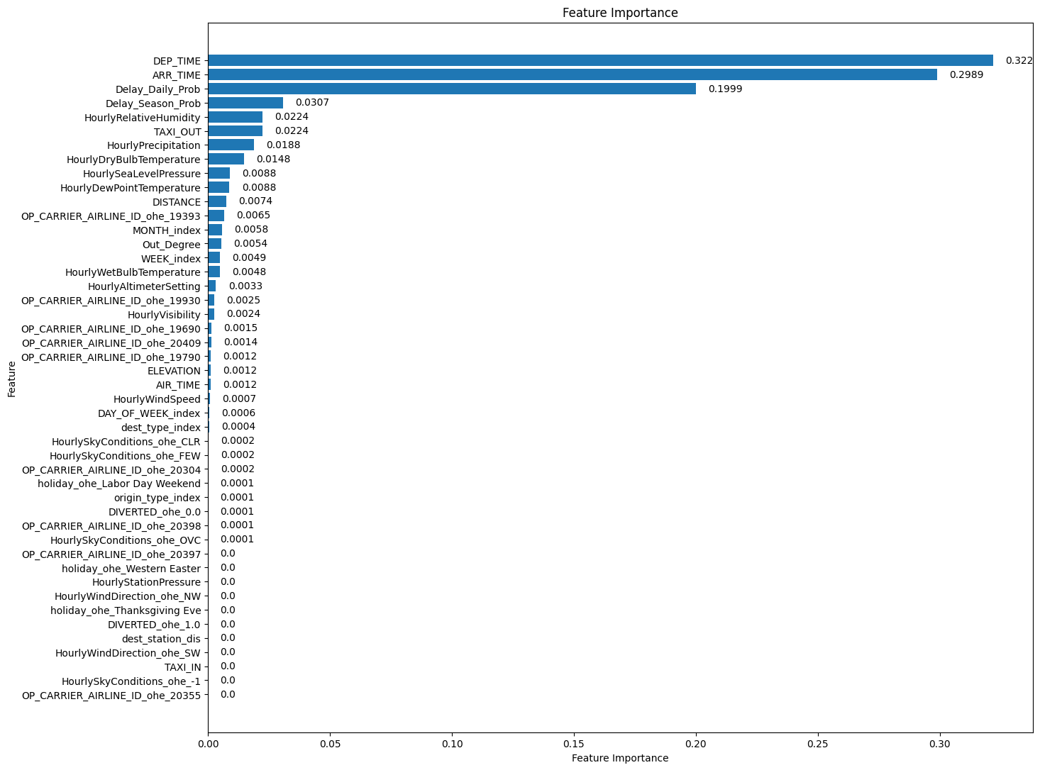
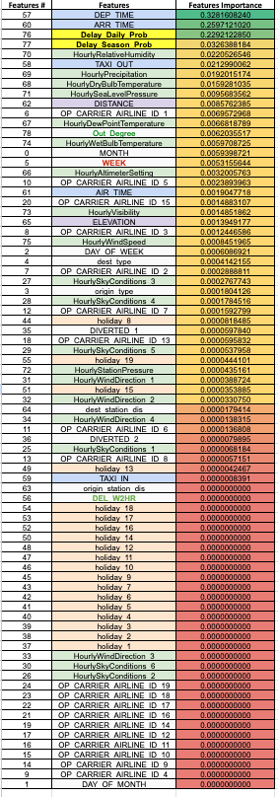
FEATURE IMPORTANCE
Notes:
Liang
We also evaluated the feature importance derived from the final Random Forest model. The top-2 most predictive features are departure time and arrival time. It suggests that certain times of the day might be more prone to delays due to congestion, air traffic, or other operational factors. Delays at the arrival end can have a cascading effect on subsequent flights and airport operations. Based on correlation matrix, it is expected as these two features also showed the highest correlation coefficients (0.16 for departure time, and 0.05 for arrival time) as in the Phase 2 report.
The third and fourth most important features are daily delay probability and seasonal delay probability. Different hours may experience varying levels of air traffic, weather conditions, or operational challenges.Different seasons can bring about diverse weather conditions and operational demands that affect flight punctuality. These two new features were created from feature engineering phase, where we observed a clear pattern between delays and hour of the day, as well as season of the year. The feature importance chart further confirms the hypothesis that there is a correlation between departure delays and the time of day and the season of flying.
We also noticed that the flight delay is more correlated to TAXI_OUT than TAXI_IN, this is likely because delayed flights usually do not have TAXI_OUT value but only TAXI_IN value. This implies a flight will be likely delayed if it has missing value for TAXI_OUT feature. It is also found that the humidity and precipitation are more useful to predict flight delays than wind direction and sky conditions. We introduced a new holiday feature, however, it turns out there is no strong correlation between flight delay and if the departure date is a holiday or not.

Slide 20
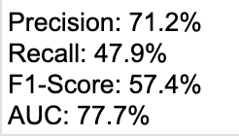
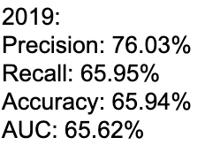
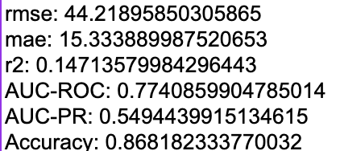
LEADERBOARD & GAP ANALYSIS
Leaderboard
Gap Analysis
Training data predates the pandemic’s impact
Weather condition data at departure airport
New feature based on PageRank
Limited number of hyperparameters
Notes:
Liang
We compared our results with other teams’ results, overall the model has moderate performance in terms of AUC and F2 score. It is worth noting that our hyperparameters are tuned based on F2 score, which has higher emphasis on the recall metric. That’s why we have relatively lower AUC and accuracy score, but higher recall metric. There are a few improvement areas for this project. The models are trained based based off of data from 2015 to 2019 which predates the pandemic's impact. There might be limitations in the generalizability of the trained model.
We also hypothesize that flight delay is mainly caused by weather conditions, however, the weather condition data is only available for departure airport but not for arrival airport. Another improvement is using the PageRank instead of outdegree to compute the importance of a given airport. Finally, the model's performance optimization is based on a limited number of hyperparameters, which does not guarantee the best performance for the given training data. A more comprehensive hyperparameter search could be beneficial to further improve the model performance.

Slide 21
CHALLENGES & NEXT STEPS
Notes:
Adam

Slide 22
CHALLENGE 1:
EXECUTION TIME
Challenge
Execution time for all runs > 1 hour
Execution time for the 60-month dataset with minor HP tuning > 10 hours
Strategies
Used 3M data set to tune HPs
Applied best HP to final model with the 60M dataset
Notes:
Adam
We explored the correlation between the total execution time and some key deciding factors including data sample size, number of hyperparameters, number of splits of validation sets. As shown in the last column, the execution time per model without any optimization is around 45min. Later we reduced the data sample size and tried using partition and parquet, the execution time is reduced to ~10mins/model, which is slightly higher than expected. Based on the observation, we inferred that it could take 93 hours to run the whole 3-month data if there are 25 hyperprameter values to try.

Slide 23
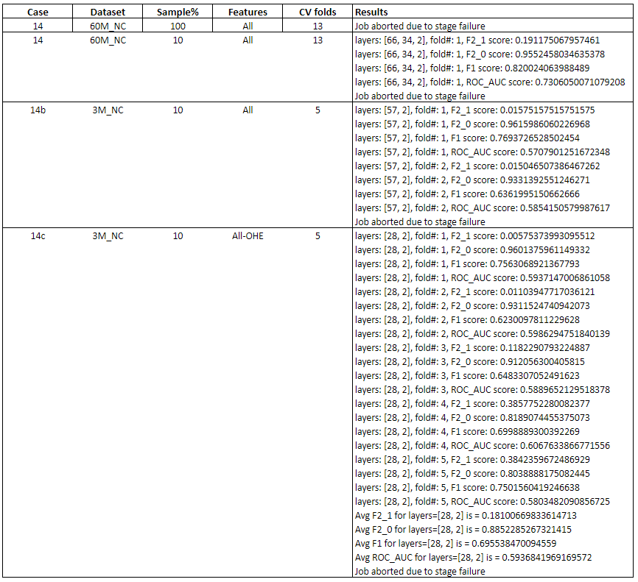
CHALLENGE 2:
NEURAL NETWORK IMPLEMENT
Same code ⇒ different results depending on data size & CV folds
Abrupt termination at different stages
Higher number of runs with smaller data size
No complete run for even 10% of 3M data
Notes:
Adam

Slide 24
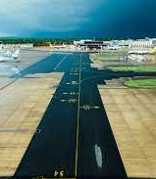
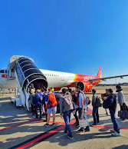


SUMMARY
Model Performance
Good performance; comparable to other team predictions
Lacks rigorous HP tuning
Key Recommendations: (to passengers)
Avoid Late flights; Top 3 indicators all related to time of departure
Avoid Flying in the Fall season
Next Steps
Solve challenges: more resources, other creative partitioning ideas, etc.
Implement other estimators besides RF + Rigorous HP tuning
Obtain weather data at destination city
Notes:
Adam

Slide 25

THANK YOU
Notes:
Adam

